Slide 1
An Introduction to Software Engineering
Chapter 2
1

Slide 2
Software Development Life Cycle
SDLC (Software Development Life Cycle)
Software Development Phases
▫ Concept Elaboration
▫ Requirements
▫ Analysis and Design
▫ Development
▫ Integration & Test
▫ Deployment & Maintenance

Slide 3
Importance
Greatly influences your chance of success
Not choosing a lifecycle is a bad option
Different Software projects require different approaches
You should know how that if given a certain scenario what sort of software process would be appropriate

Slide 4
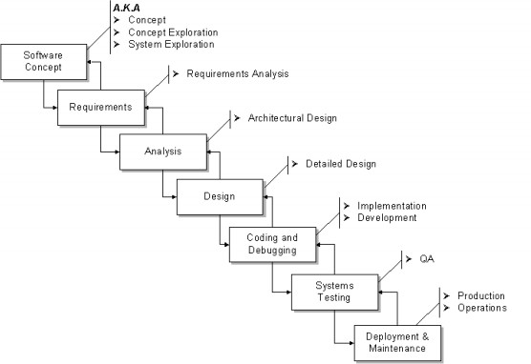
Software Development Phases

Slide 5
Concept Elaboration
The “Why” phase
Not a “mandatory formal” phase
▫ Sometimes called the “pre-project” phase
Collecting project ideas
▫ Then the “funneling” process
Project Justification
Initially rough Estimations

Slide 6
Software Requirements
The “What” phase
The process of establishing what services are required and the constraints on the system‟s operation and development.
Requirements engineering process
▫ Feasibility study
Is it technically and financially feasible to build the system?
▫ Requirements elicitation and analysis
What do the system stakeholders require or expect from the
system?
▫ Requirements specification
Defining the requirements in detail
▫ Requirements validation
Checking the validity of the requirements

Slide 7
Feasibility report
Project tile:
Introduction :
Technical feasibility
Economic feasibility
Operational feasibility
Schedule feasibility
Final recommendation

Slide 8
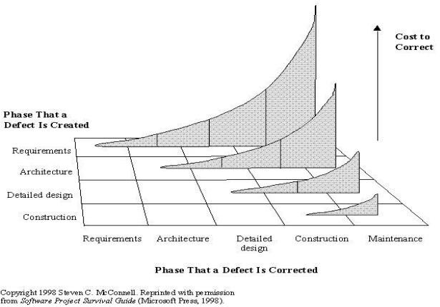
Why are Requirements so Important?

Slide 9
Software design
The process of converting the system specification into an system design.
Software design
– Design a software structure that realises the specification;
The activities of design and implementation are closely related and may be inter-leaved.

Slide 10


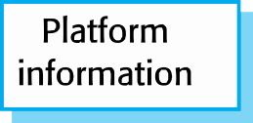
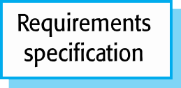
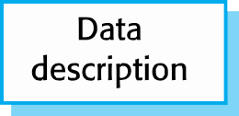

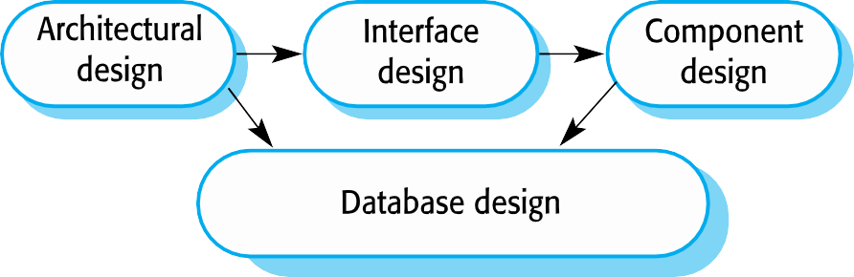

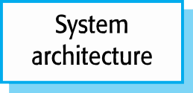
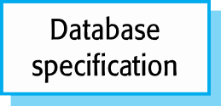
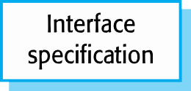
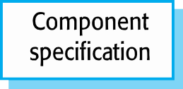
A general model of the design process

Slide 11
Design activities
Architectural design, where you identify the overall structure of the system, the principal components (sometimes called sub-systems or modules), their relationships and how they are distributed.
Interface design, where you define the interfaces between system components.
Component design, where you take each system component and design how it will operate.
Database design, where you design the system data structures and how these are to be represented in a database.

Slide 12

Development
The “Do It” phase
Actual coding/programming
Coding & Unit testing
Other concurrent activities

Slide 13
Software validation (Testing)
Verification and validation (V & V) is intended to show that a system conforms to its specification and meets the requirements of the system customer.
Verification : Are we building the product right? (process)
Validation: Are we building the right product? (product)

Slide 14
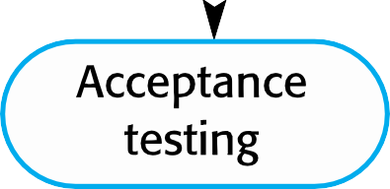
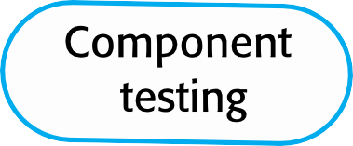
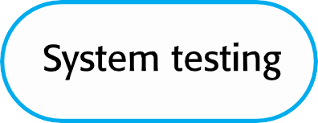
Stages of testing

Slide 15
Testing stages
Development or component testing
▫ Individual components are tested independently;
▫ System testing
▫ Testing of the system as a whole. Testing of emergent properties is particularly important.
Acceptance testing
▫ Testing with customer data to check that the system meets the customer‟s needs.

Slide 16
Software evolution
Software is inherently flexible and can change.
As requirements change through changing business circumstances, the software that supports the business must also evolve and change.
Although there has been a discrimination between development and evolution (maintenance) this is increasingly irrelevant as fewer and fewer systems are completely new.

Slide 17
Key points
Software processes are the activities involved in producing a software system. Software process models are abstract representations of these processes.
General process models describe the organization of software processes. Examples of these general models include the „waterfall‟ model, incremental development, and reuse- oriented development.

Slide 18
Key points
Requirements engineering is the process of developing a software specification.
Design and implementation processes are concerned with transforming a requirements specification into an executable software system.
Software validation is the process of checking that the system conforms to its specification and that it meets the real needs of the users of the system.
Software evolution takes place when you change existing software systems to meet new requirements. The software must evolve to remain useful.

Slide 19

For any query Feel Free to ask

